Slide 1
Deep contextualized word representations
Paper reading
Tianle Zhang s1678924
Notes:
This is the second pre of my final project.

Slide 2
Section 1
Introduction
Abstract
Background

Slide 3
Abstract
a new type of deep contextualized word representation
can be easily added to existing models
signiﬁcantly improve the state of the art across six challenging NLP problems

Slide 4
Background
Pre-trained word representations are a key component
(Mikolov et al., 2013; Pennington et al., 2014)
BUT
learning high quality representations can be challenging

Slide 5
Background
A satisfying word representation should ideally reflect
Complex characteristics of word use (e.g., syntax and semantics)
How these uses vary across linguistic contexts (i.e., to model polysemy)
Our method also
Can be easily integrated into existing models
Improves the state of the art in every considered case

Slide 6
Section 2
ELMo
Traditional Method
biLSTM
ELMo

Slide 7
Word Embedding Methods
Traditional word embeddings:
e.g., word2vec, Glove, etc.
MT encoder :
e.g., CoVe (McCann et al., 2017)
ELMo:
Multi-layer LSTMs
functions of the entire input sentence

Slide 8
Word Embedding Methods
 | Traditional word embeddings | ELMo
Relationship with context | Context-independent | Context-dependent
Input | a word | entire input sentence
Output | a word vector | sequence of word vectors
Look-up Table
word
word vector
静态
biLSTM
input sentence
sequence of word vectors
动态

Slide 9


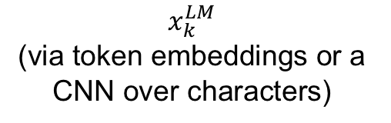
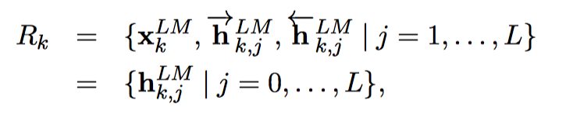
biLSTM: bidirectional LSTM
每个token tk 拥有2L+1个representation

Slide 10
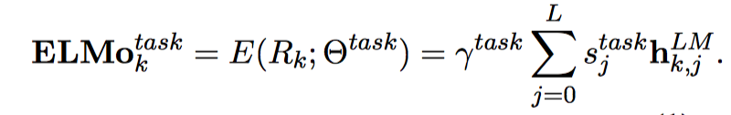
ELMo
ELMo: Embeddings from Language Models
ELMo is a task speciﬁc combination of the intermediate layer representations in the biLM.
word representation

Slide 11
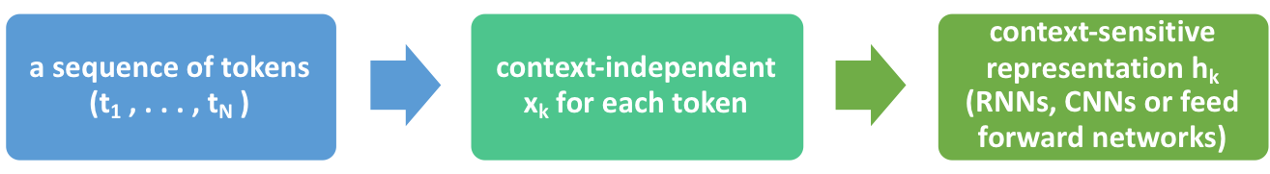
Apply to supervised NLP tasks
typical specific task：
add ELMo to the supervised model
adding λ||w||² ₂ to the loss
x_{k} —> [x_{k};ELMo_{k}¹]
h_{k}—>[h_{k}; ELMo_{k}²]

Slide 12
Section 3
Analysis
Evaluation
Comparation

Slide 13
Why design like so?
Bi-directional LSTM

Slide 14
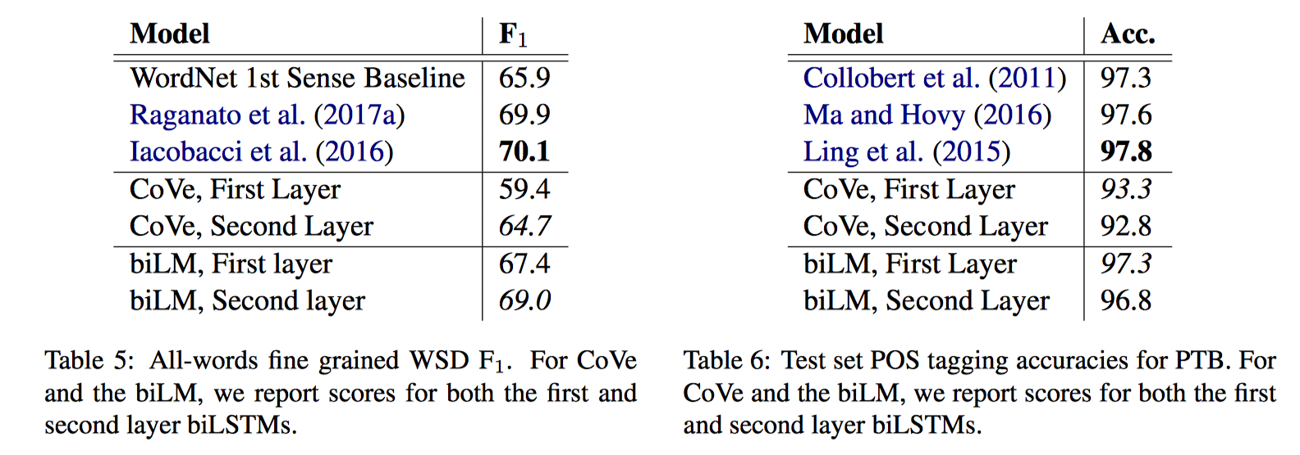
Why design like so?
Deep LSTM
word sense disambiguation (WSD)
Different layers have different information (compared with CoVe)
ELMo & hidden state in CoVe

Slide 15
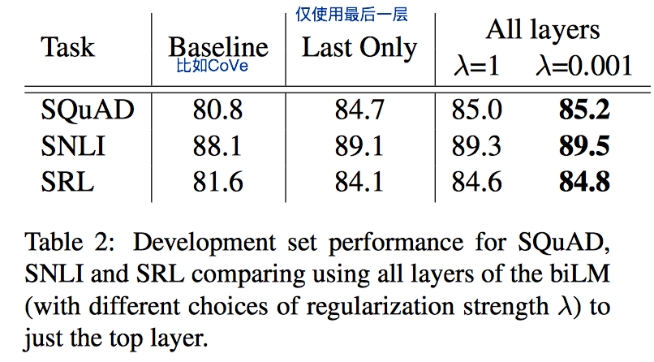
Why design like so?
Deep LSTM
task-specific (sentimental, POS, machine translation)
improvement

Slide 16
Why design like so?
Input sentence instead of word
traditional word embedding: vector addition
context-dependent

Slide 17
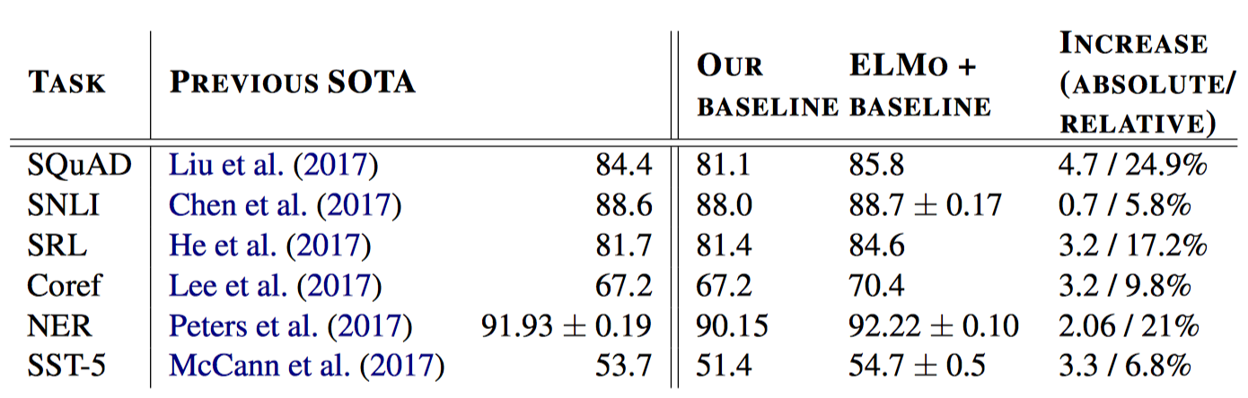
Evaluation
Question answering, Textual entailment (文字蕴涵), Semantic (语义) role labeling,
Coreference resolution(指代消解), Named entity extraction(专名识别), Sentiment analysis

